Slide 1
Applications of Heaps
EECS 233

Slide 2
Application #1: Heap-sort
Sorting algorithms: given an arbitrary array, re-position the items in the array in ascending or descending order
A naïve algorithm (we will learn more later)
It isn’t efficient (O(n²)), because it performs a linear scan to find the smallest remaining item.
15
7
13
5
4
6
11
16
9
4
7
13
5
15
6
11
16
9
4
5
13
7
15
6
11
16
9
4
5
6
7
15
13
11
16
9

Slide 3
Heap-Sort
Heap-sort is a sorting algorithm that repeatedly finds the largest remaining item from a heap and puts it in place.
  void heapSort(T[] arr, int numItems) {
    // Turn the array into a max-at-top heap.
    buildHeap(arr, numItems);
    int endUnsorted = numItems - 1;
    while (endUnsorted > 0) {
      // Get the largest remaining item and put it to the end
      T largestRemaining = removeMax(arr);
      arr[endUnsorted] = largestRemaining;
      endUnsorted--;
    }
  }
It is efficient:
  O(N) to turn the array into a heap
  O(log N) to remove the largest remaining item
  N above removals
  O(N log N) overall

Slide 4
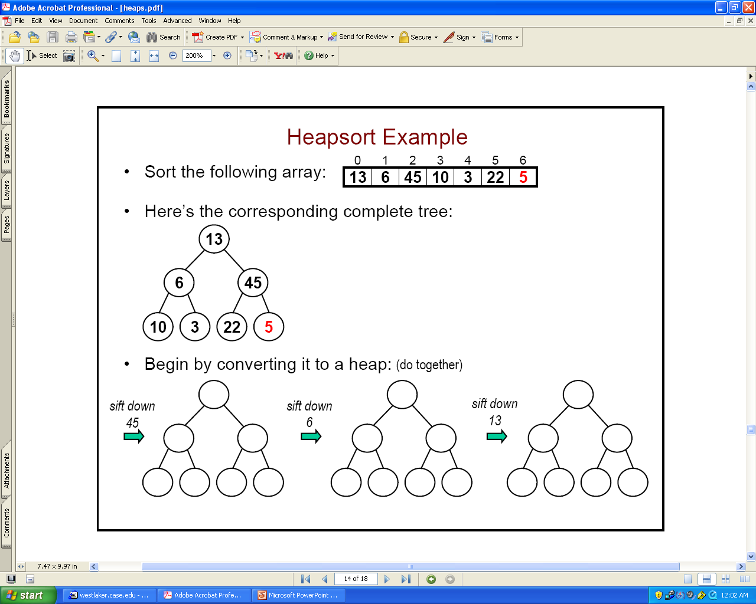
Heap-Sort Example: (1) Build the Heap
Sort this array:
The corresponding complete tree:
First call BuildHeap():
13
6
45
10
3
22
5
5
45
10
10
22
5
6
5
6
13
5

Slide 5
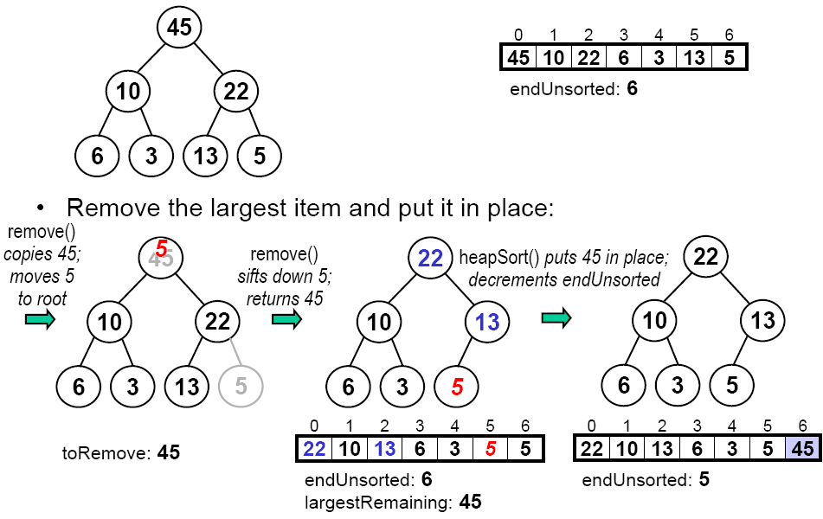
Heap-Sort Example: (2) Drain the Heap
Remove the largest item from heap:

Slide 6
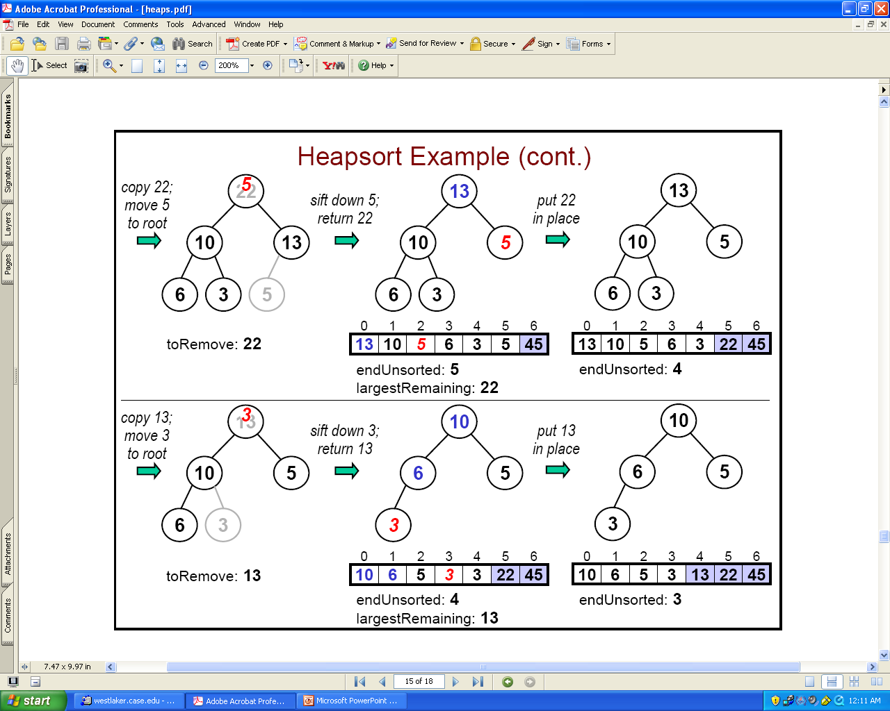
Remove the Next Largest Items

Slide 7
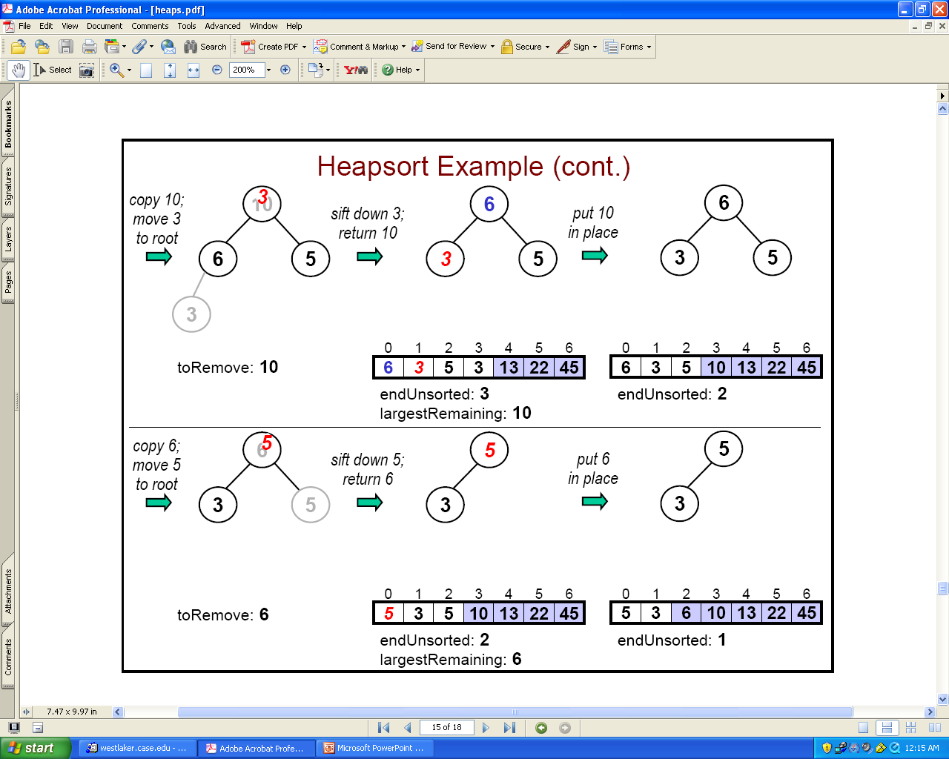
Keep Going

Slide 8
Application #2: The Selection Problem
Given an array of N items and an integer k (1 <= k <= N), find out the k-th largest item (or k largest items) in the list. E.g., N=1,000,000 and k=100, or k=N/2
Example:
  Array of items: 4, 9, 0, 3, 5, 7, 10, 12, 2, 8
  12 10 9 8 7 5 4 3 2 0 (sorted order of items)
  1st largest item is: 12
  10th largest item is: 0
  6th largest item is: 5
What is your method?

Slide 9
The Selection Problem: Naïve Methods
Naïve method 1
  Sort N items: O(N²) (for a simple sort algorithm), O(NlogN) for heap-sort (and a number of other algorithms we will learn)
  Retrieve the k-th largest item: O(1)
No so naïve method 2
  Read k items into an array A: O(k)
  Sort the items in the array A: O(k²) (actually O(k log k) but no matter)
  For each of the remaining items: (N-k) of them (new_item)
    Compare new_item to the last (smallest) item in A, last_item. If new_item is larger than last_item, replace last_item with new_item and put the latter into correct spot in the array: O(k)
  The final array contains the top-k items
  Total Running time: O(k + k² + (N-k) * k) = O(Nk).

Slide 10
The Selection Problem: Efficient Method 1
Use heaps!
To find the k-th largest item.
  Apply buildHeap() to the array O(?)
  Perform k removeMax() operations. O(?)
    Last operation will give us the k-th largest one.
What is the total running time? O(?)
O(N + klogN)

Slide 11
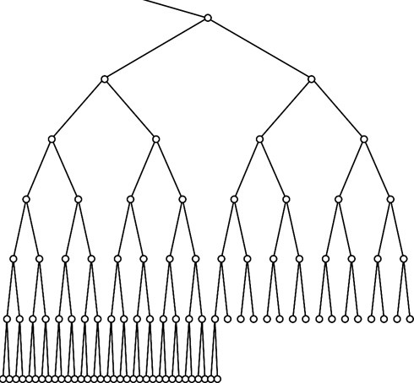
Exercise: Update An Item
Update an item and return the old one
public T update(int i, T item) {
  T oldItem = items[i];
  ?
  return oldItem;
}
Running time?
items[i] = item;
if (item.compareTo(oldItem) == 1)
siftUp(i);
else
siftDown(i);
23
45
23
17

Slide 12
Delete An Arbitrary Item (Not RemoveMax())
public T delete(int i) {
  T toDelete = items[i];
  ?
  return toDelete;
}
Running time?
items[i] = item[numItems - 1];
numItems--;
if (toDelete.compareTo(items[i]) == -1)
siftUp(i);
else
siftDown(i);
23
45

